Slide 1
DISEASE PREDICTION
--By Team IDK--
Team members: M.M.NAVADEEP(99220041253)
T.V.SUJITH GOPI(99220041389)
N.GOPI KRISHNA(99220041274)
D.SATWIK CHOWDARY(99220041

Slide 2
Problem Statement
The objective of this project is to develop a robust and accurate disease prediction system that can predict the type of disease a patient may have based on their symptoms and medical profile. The model should take into account various symptoms, age, gender, blood pressure, and cholesterol level as input features and provide the predicted disease name as the output.

Slide 3
Analysis of Problem
Develop a machine learning model that can accurately predict the disease name based on the given symptoms and patient information.
Achieve high accuracy and reliability in disease prediction to ensure that patients receive accurate and timely diagnoses.
Handle the challenges posed by imbalanced data, complex relationships between symptoms and diseases, and variations in patient profiles.
Ensure that the model is interpretable and can provide insights into the factors influencing disease prediction.
Enable the integration of the model into a user-friendly application or platform for healthcare professionals to use.

Slide 4
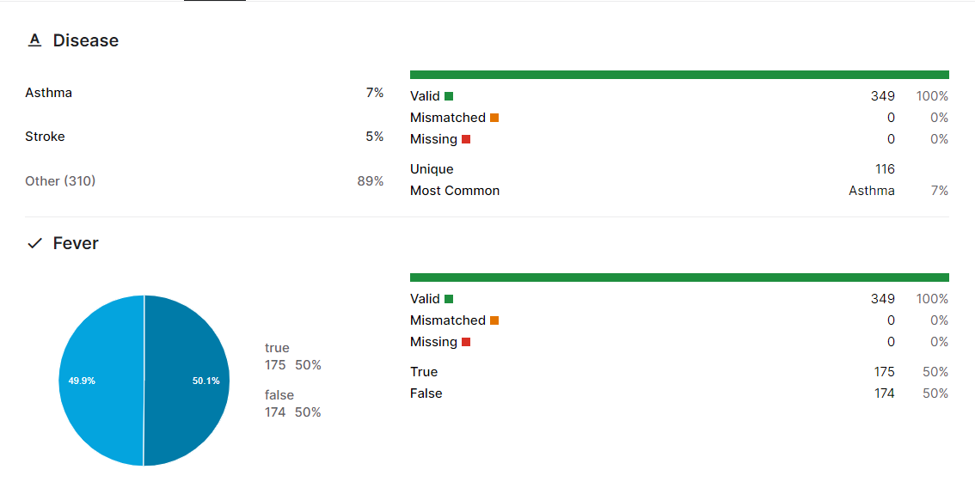
Dataset
The project utilizes a dataset that includes information on various diseases, patient symptoms, age, gender, blood pressure, and cholesterol levels. The dataset is used for model training, testing, and validation.
Now, let’s see the column-wise depiction of dataset:

Slide 5
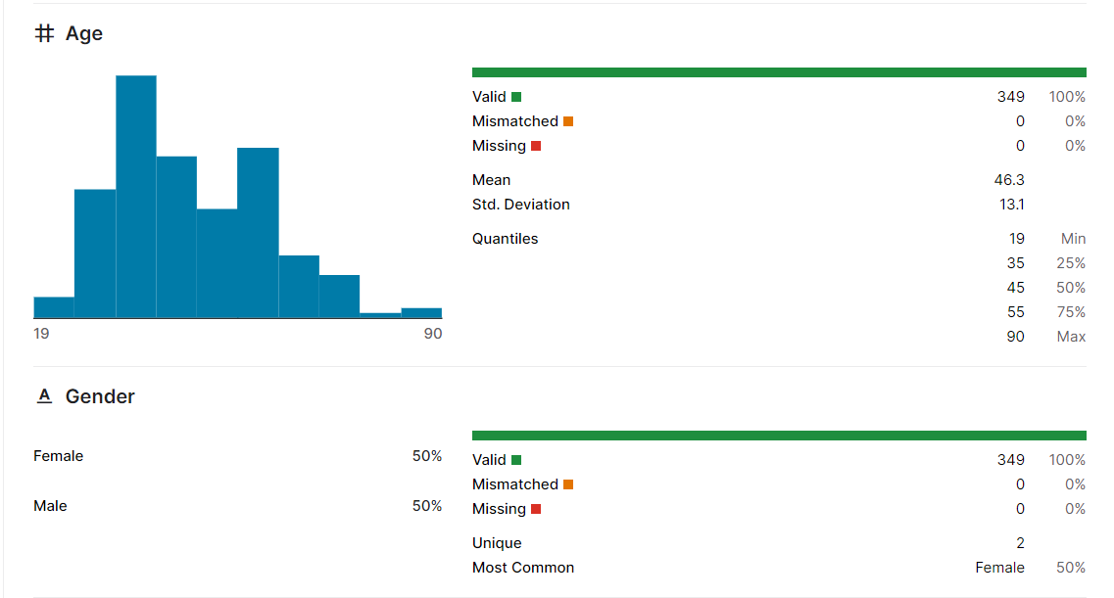
More Information of the dataset is provided in: “https://www.kaggle.com/datasets/navadeep2004/disease-prediction-based-symptom-medical-history”

Slide 6
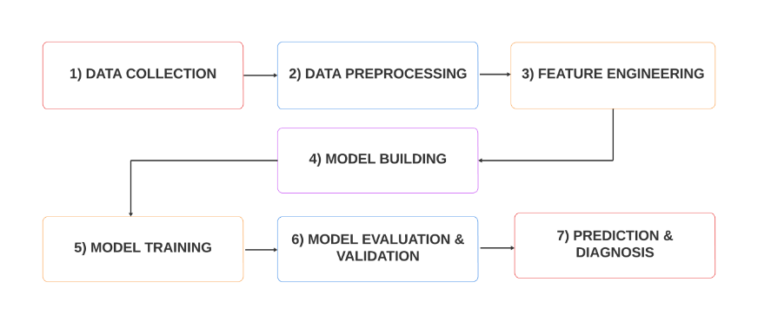
Block Diagram

Slide 7
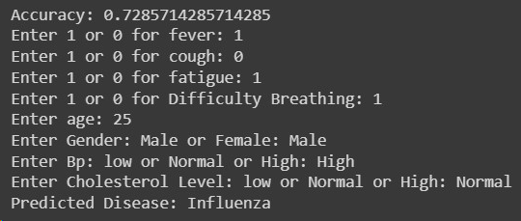
Output
The primary output of this project is the predicted disease name based on the input symptoms and medical profile of a patient. The model aims to provide an accurate and specific disease name (e.g., "Influenza," "Common Cold," "Asthma," etc.) as the prediction.

Slide 8
Conclusion
The Disease Prediction project aims to provide a valuable tool for healthcare professionals in diagnosing diseases based on patient symptoms and medical profiles, contributing to better patient care and outcomes.

Slide 9
References
Kaggle: https://www.kaggle.com/search?q=disease+prediction
AI chatbots
https://www.coursera.org/specializations/machine-learning-introduction
This link is used as Reference to get to know about datasets.
ChatGPT is used as a reference to get to know more about Models.
This is a machine learning introductory course.

